Slide 1
Customer attrition prediction
By. Thomas Loyola C

Slide 2
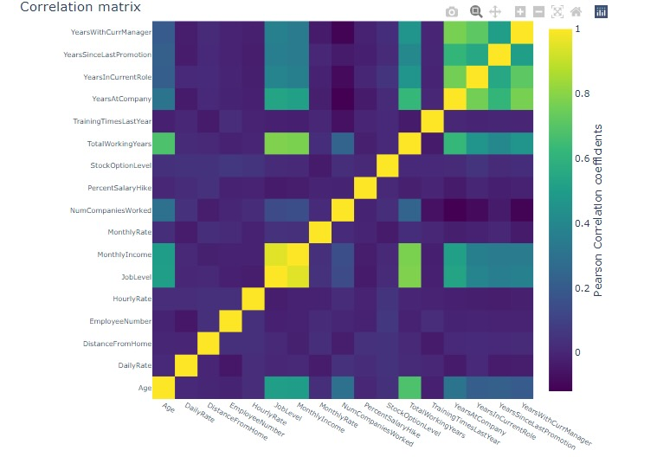

Slide 3
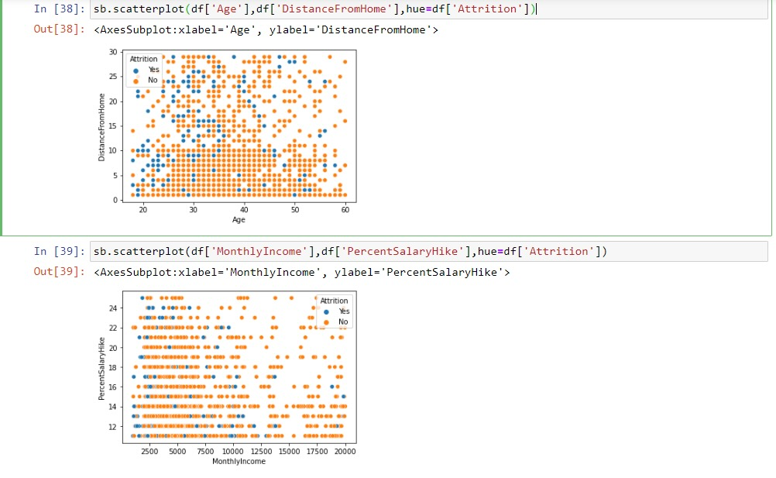
If a person has low monthly income and low percentage hike it leads to attrition

Slide 4
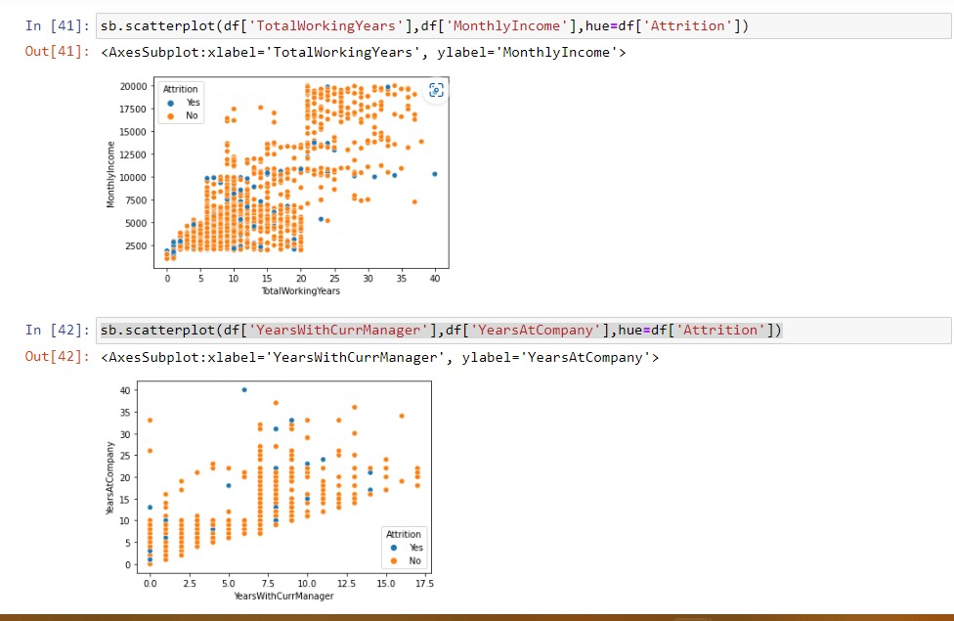
If a person didn't get good pay it leads to attrition because the aged persons are churned because of less pay

Slide 5
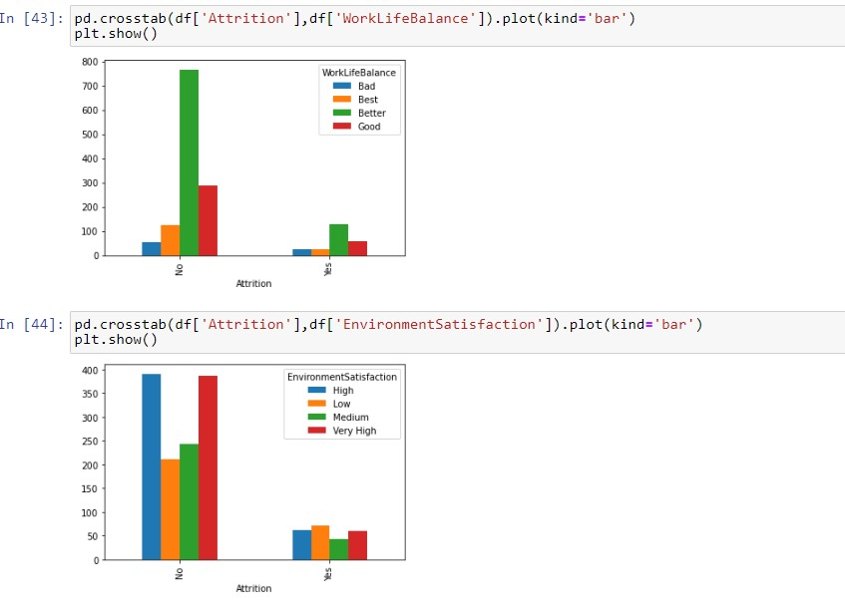
If a person didn't get an environmental satisfaction ,then it leads to churn

Slide 6
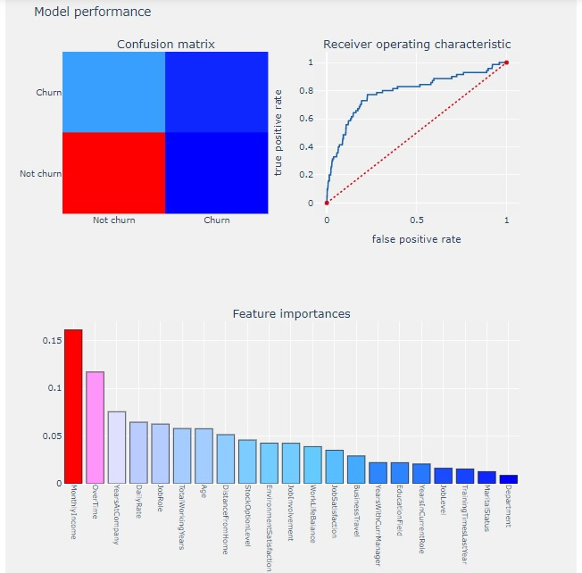
Accuracy score is 87.
My final model is Gradient boosting Classifier.

